Slide 1
Introduction to Studio 5000 and Siemens
© 2022 John Sefcovic.

Slide 2
Data Tags
A PLC uses Data Tags and Logic Programs to control an Application.
Data Tags
Data Tags are descriptive Names given to the Data Types used by the PLC Application.
The Data Types uses industry standards to define the format of the data, such as, Boolean (1 bit), Single Integer or Byte (8 bits), Integer (16 bits), Double Integer (32 bits), Real (Decimal place numbers), and String (text).
These Data Types format the data for the Input and Output Field Devices, Timers and Counters set points, Arithmetic calculation, Comparison of values, and other application data.
Studio 5000 and Siemens use different terms and structures for data usage, except Data Types are the same for both systems.

Slide 3
Logic Programs
A PLC uses Data and Programs to control an Application.
Logic Programs
Logic Programs contain the Input Logic Instructions that Interpreters the Data and solves the instructions to Change the Data to Control the application with Output Logic Instructions.
In the application one Program is Continuously Scanned and the other Programs are “called” or Scanned when needed.
Studio 5000 and Siemens use different terms and structures for these “called” programs.

Slide 4
Ladder Logic Diagrams
The program files are made up of “Rungs" or “Networks” of instructions that are examined to be True based upon what information is in the data files.
The instructions create a “Logic Circuit”.
A complete “Left to Right” path of TRUE Input instructions in the “Logic Circuit” will cause a TRUE Output action.
The True path is “Logic Continuity”
Software’s terms for the Logic Circuit:
Studio 5000 uses the term Rung.
Siemens uses the term Network.

Slide 5


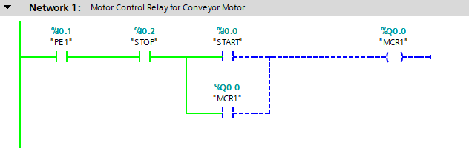
Ladder Logic Diagrams
Siemens
A Siemens Network shows Logic Continuity Flow. A True instruction is shown in green two different ways.
True instruction with Logic Continuity Path
True instruction without a Logic Continuity Path
True instructions
with Logic Continuity Flow.
False instructions and interruption of Logic Continuity Flow.

Slide 6

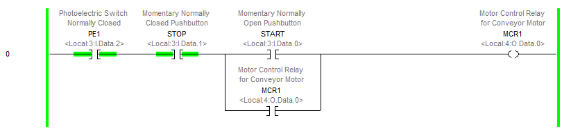
Ladder Logic Diagrams
Studio 5000
A Studio 5000 Rung does not show Logic Continuity Flow between Instruction, a True instruction is shown in green.
True instructions, Logic Continuity Flow is not shown but is established.
False instructions and Logic Continuity Flow is not established.

Slide 7
Studio 5000

Slide 8
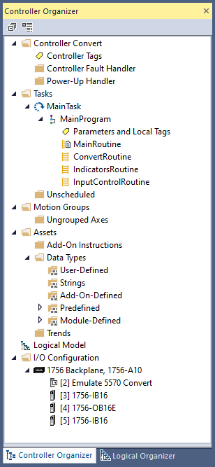
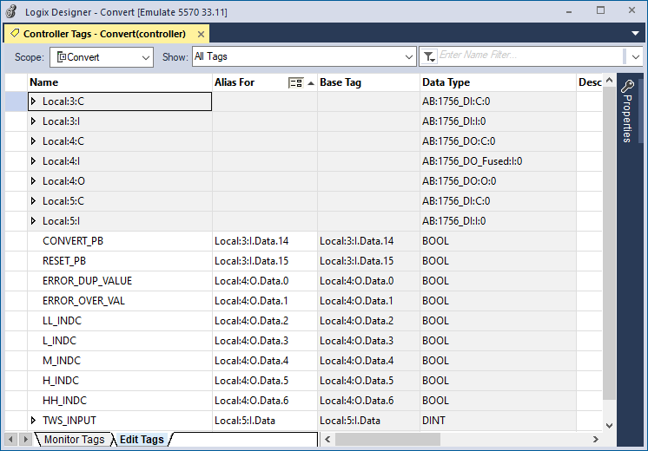
Studio 5000
Controller Tags are Global Data and can be accessed by any program.

Slide 9
Studio 5000
The Controller Tags list the Hardware Address of the PLC’s Inputs and Outputs.
The application’s Field Devices are wired to the Input and Output modules for the Data the PLC’s Programs Interprets and Controls.
Note: Networked Input and Output Data Addresses are also listed in the Controller Tags.

Slide 10
Studio 5000
The Hardware Address are assigned a descriptive Tag Name.

Slide 11
Studio 5000
The Tag Name is an Alias For a specific Hardware Address.

Slide 12
Studio 5000
Each Tag has a Data Type.

Slide 13
Studio 5000
Tags that are not associated with the I/O Hardware may be defined as Controller Tags.
The Tags are for additional Global Data used by the application’s Programs.

Slide 14
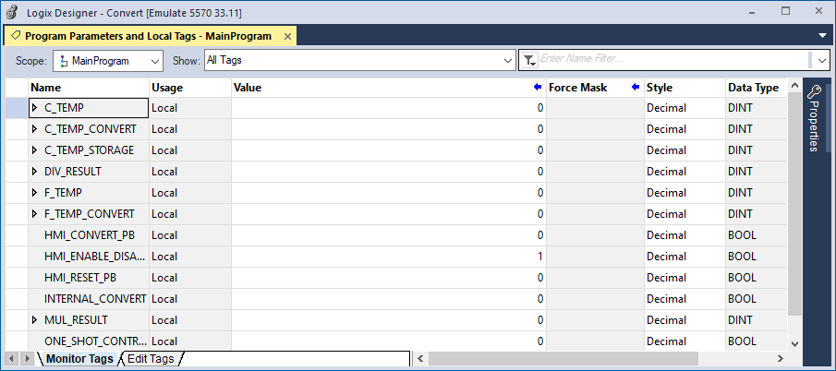
Studio 5000
Parameter and Local Tags are a descriptive Tag Name for a Data Type used by the Logic Instructions.
Note: Program Parameter and Local Tags may also use Tag Names for I/O Hardware Alias For.

Slide 15
Studio 5000
Parameter and Local Tags can only be accesses by the Programs where they are defined, Local Tags.
An Application may have more than one Program and only the Local Tags defined in that program can be accessed by that program.

Slide 16
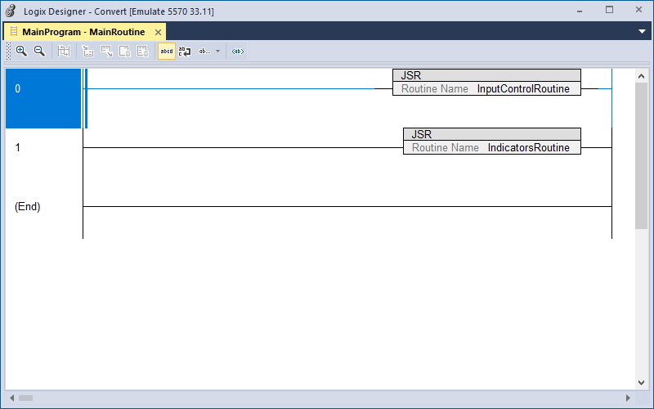
Studio 5000
A MainProgram contains the Main Routine. The MainRoutine is Continuously Scanned and “calls” other Routines.
All programming structures with the Logic Instructions are Routines.

Slide 17
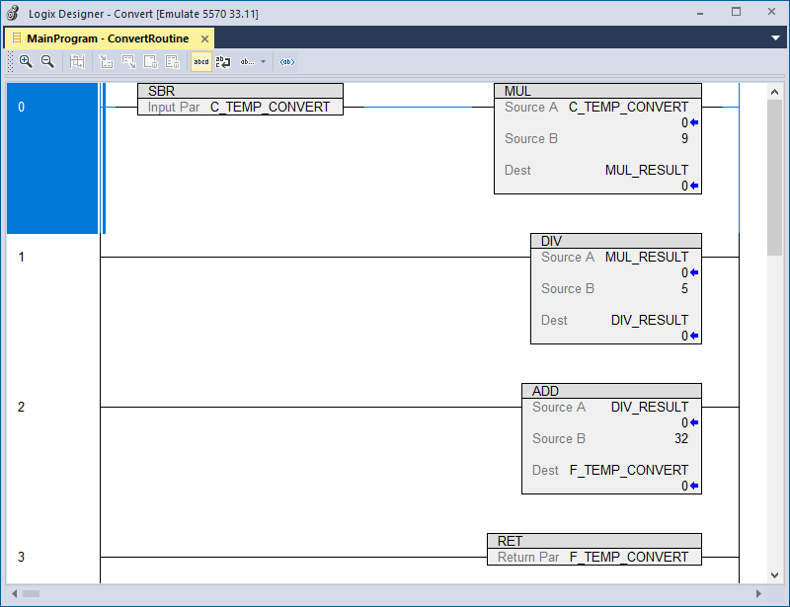
Studio 5000
Additional Routines are called by the MainRoutine.
When the Scanning or execution of the Routine is complete scanning returns to the MainRoutine.
Note: A “called” Routine can call other program Routines and execution returns to the “calling” Routine.

Slide 18
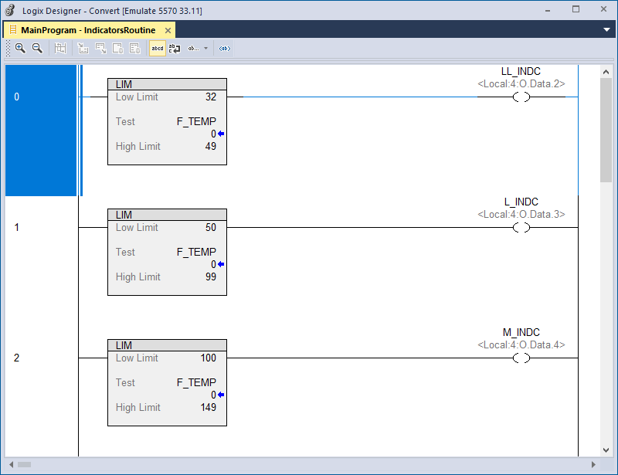
Studio 5000
Routines are usually used to divide the program into the “functional area” of the Application.

Slide 19
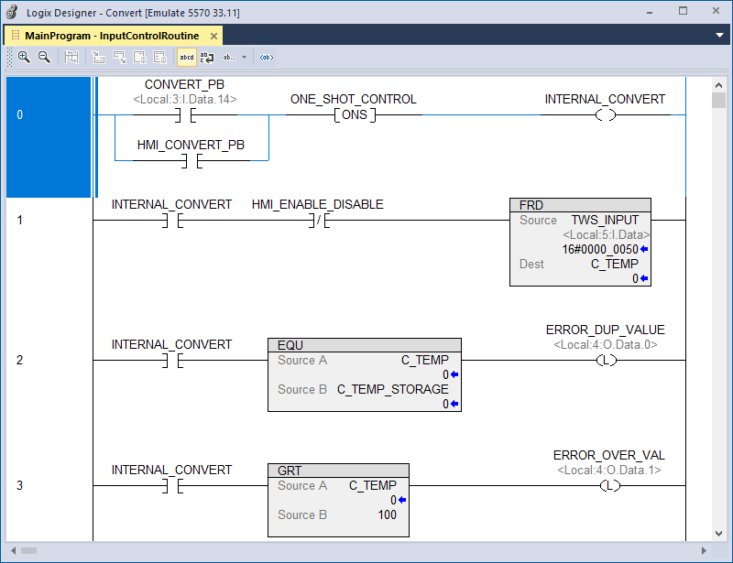
Studio 5000
Remember, when the “Called Routine” scanning is complete execution returns to the “Calling Routine.”
Routines may be called “Conditionally” when needed or “Unconditionally” and executed in the order of the instructions calling the Routines.

Slide 20
Siemens

Slide 21




Siemens
Siemens uses the term “Block” for the Program Structures containing the Logic Instructions. These are:
Organization block
Function
Function block
The Organization Block holds the Main program and is continuously scanned to execute the Logic Instructions in the program to control the machines or processes.
An application can be structured where one Block of program instructions calls another Block of program instructions, a sub-program or subroutine, to be executed for the control of the equipment by the PLC.

Slide 22



Siemens
The called programming Blocks are:
Functions [FC] subroutine program blocks are without dedicated memory to share Tag data values with other programming blocks.
The Tag data in Functions [FC] are Local to that Function [FC]. Use of Local Tags in a Function [FC] is optional.
Function Blocks [FB] subroutine program blocks and store tag data values in Data Blocks [DB] for sharing data with the calling block.
Data Blocks [DB] store their Tag values that are associated with the Function Blocks [FB]. The Tag data values can be used by other programming blocks.
The Tag data values in Data Blocks [DB] are Global.

Slide 23


Siemens
Data Tags are defined in two structures. These structures are Global, and their data can be accessed by any program.
PLC tags
Data blocks
The PLC Tags list the Hardware Address of the PLC’s Inputs and Outputs. The applications Field Devices are wired to the Input and Output modules for the Data the PLC’s Programs Interprets and Controls.
Data blocks contains descriptive Tag Names for a Data Type used by the Logic Instructions.
Note: Multiple Data blocks may be defined.

Slide 24
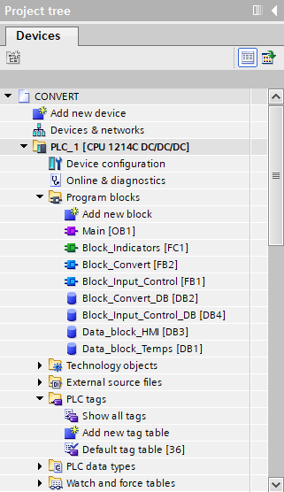
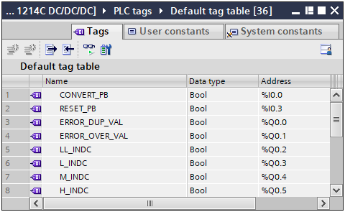
Siemens
PLC tags are defined in the Default tag table.

Slide 25
Siemens
A descriptive Tag Name…

Slide 26
Siemens
A descriptive Tag Name…
… is assigned to the PLC’s Input and Output Hardware Addresses.

Slide 27
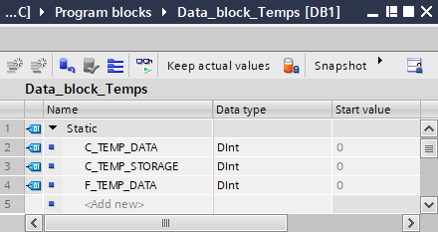
Siemens
Data blocks are structures containing Tags for additional Global Data used by the application’s Programs.
Note: Multiple Data blocks may be defined.

Slide 28
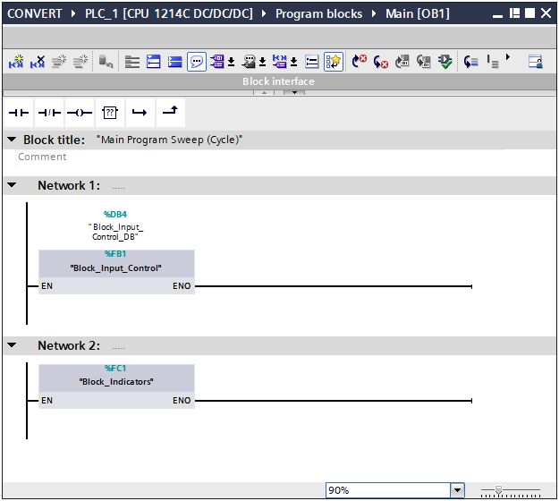
Siemens
The Organization Block is a Programming Block and is Continuously Scanned and “calls” the other Programming Blocks.

Slide 29
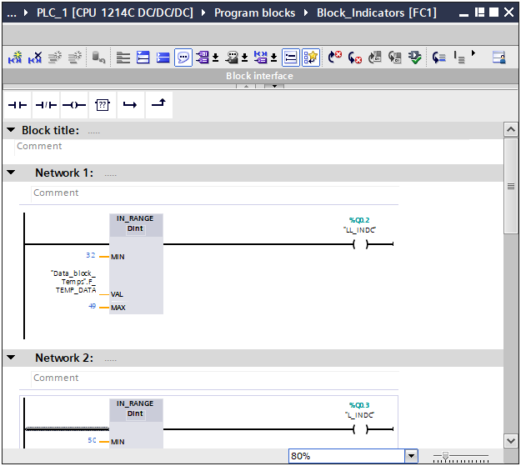
Siemens
A Function is a Program Block that is “called” to be scanned or executed.
Note: A “called” Programming Block can call other Program Blocks and execution returns to the “calling” Program Block.

Slide 30
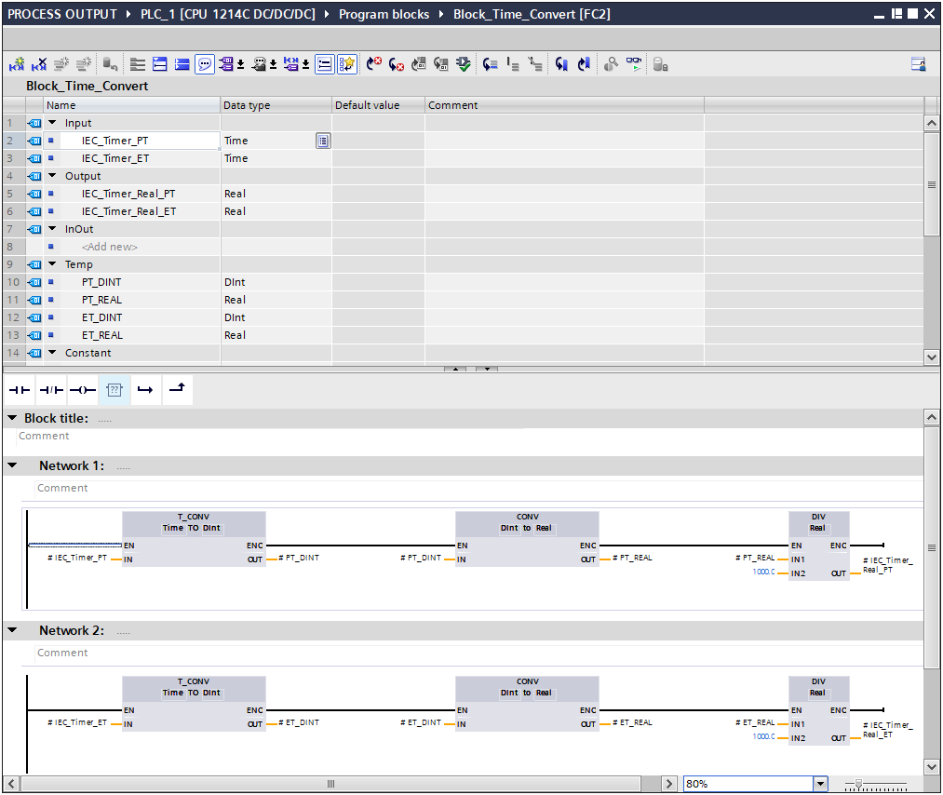
Siemens
Local Tags may be defined in a Function.
The Data Tags are defined in the Function’s Interface.
These Local Data Tags can only be accessed by the Function the Tags were defined in.

Slide 31
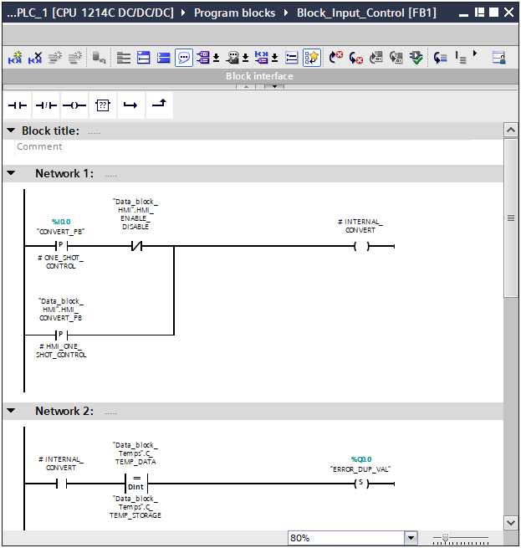
Siemens
A Function Block is a Program Block that is “called” to be scanned or executed.

Slide 32
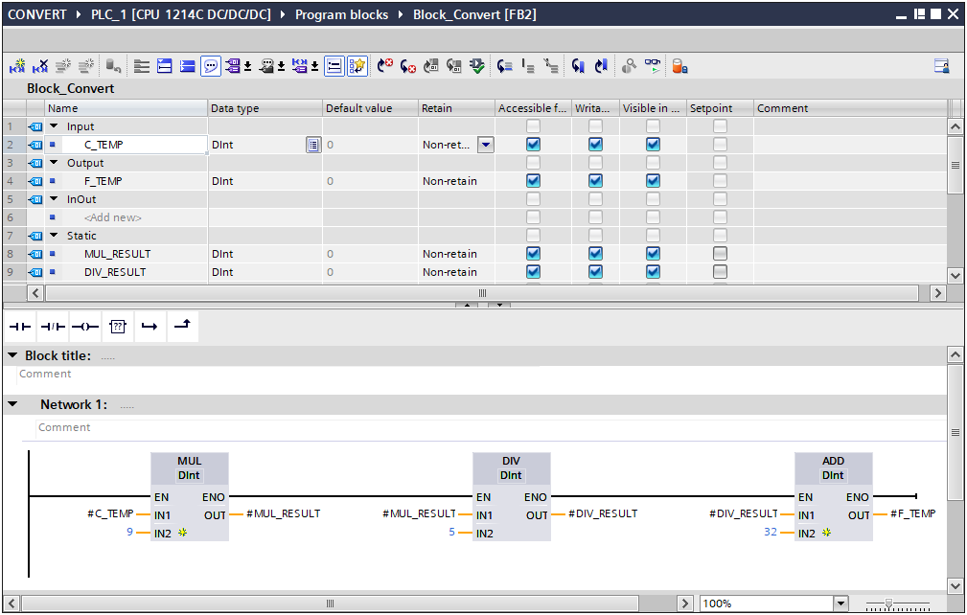
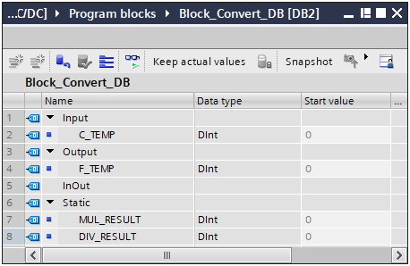
Siemens
A Function Block has an associated Data Block.

Slide 33
Siemens
The Tags in the Data Block are defined in the Function Block’s Interface.
The Data Block Data Tags are Global and can be accessed by any other Programming Blocks.

